Slide 1
Software Development for the Internet
Introduction

Slide 2
Course Outcomes
Internet Software Development
  Java webapps
  J2EE architecture
JSP (Java server pages)‏
  Webapp framework
XML (extensible markup language)‏
  Data structure & representation
  Data validation & transformation

Slide 3
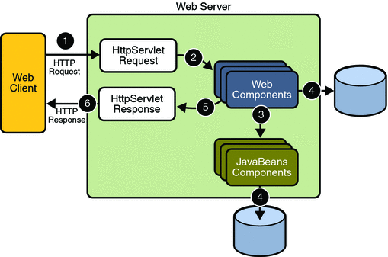
Web Server Basics

Slide 4
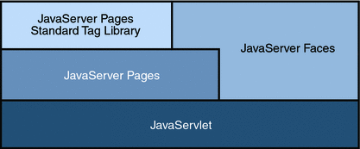
Java Web Technologies

Slide 5
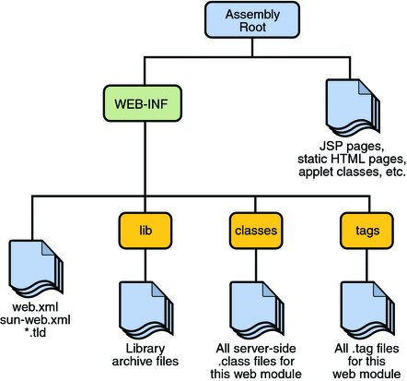
Webapp

Slide 6
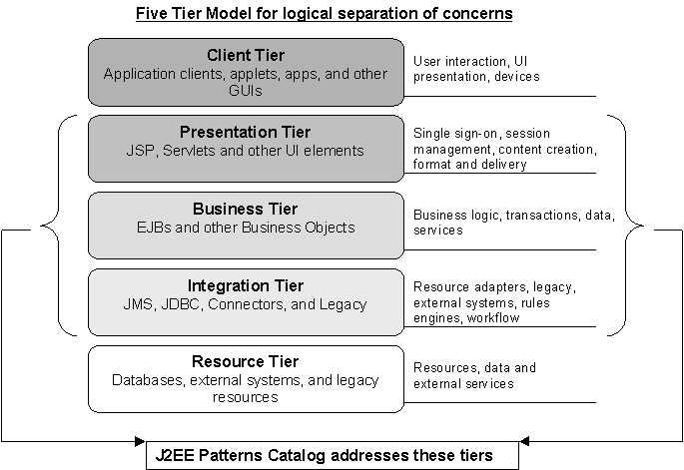
J2EE Application Architecture

Slide 7
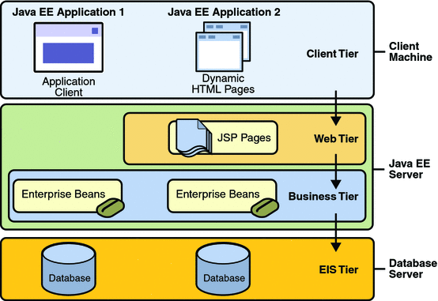
J2EE Deployment

Slide 8
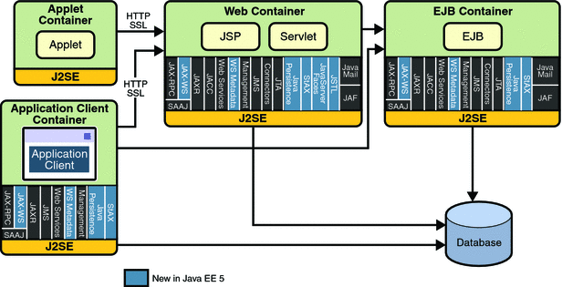
J2EE Technologies

Slide 9
Java Servlets
Java programs that execute inside a web container & handle HTTP requests
"Server side" code
Produces HTML intended for browser consumption and display
javax.servlet & javax.servlet.http

Slide 10
Servlet Mechanics
Singletons, controlled by thread pool in web container
service(request,response)‏
doXXX(request,response) methods to handle HTTP: get, post; delete, head, options, put, trace

Slide 11
Web Container Framework
Container
Context
Session
Page
Request
Response

Slide 12
Java Server Pages
Built on top of servlets
A Java Server Page is turned into a servlet (Java program) by the JSP container
HTML with embedded Java code
Response to Active Server Pages (Microsoft)‏
Considered part of J2EE presentation tier

